Slide 1
Urban Pulse: Smart Mobility
Milestone 2: Data Modeling & DAX in Power BI | Madhuri Gundlakunta

Slide 2

Milestone 2: Objectives
Integrate & structure Urban Pulse datasets
Transform and prepare raw data
Design fact and dimension tables
Build a dedicated Date dimension
Establish table relationships
Implement DAX measures & calculated columns
Build KPI-driven Power BI visuals
Prepare model for scalable mobility analysis

Slide 3

Urban Pulse Data Ecosystem
Fact Tables
Dimensions
Design Principle
Urban Mobility: vehicles, traffic, road occupancy, ride-sharing, emissions, energy.
Trip Data: individual trip records (miles, purpose, category, start/stop).
Weather Station: station and geographic reference info.
World Cities: city, country and geographic details.
World Happiness: happiness, economic and social indicators.
Five datasets organized by analytical role (fact vs. dimension) into a star schema, not blindly merged into one flat table.

Slide 4
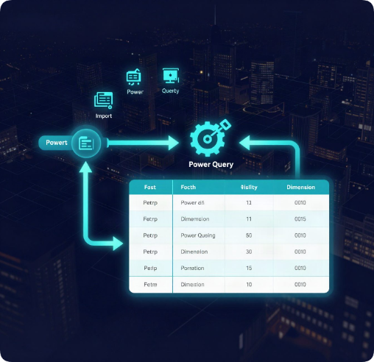
Data Prep
Pipeline: Raw Data → Power BI → Power Query.
Validated data types; built Mobility_Date from Timestamp & Trip_Start_Date.
Created Dim_Date (Year, Month, Quarter, Day).
Renamed Fact/Dimension tables; finalized structure for relationships.

Slide 5
Fact Tables Overview
Fact_Mobility (event-level metrics):
Timestamp, Vehicle_Count
Traffic_Speed_kmh, Road_Occupancy_%
Ride_Sharing_Demand, Emissions
Energy, Parking, Accidents
Weather/Traffic Conditions
Fact_Trips (trip-level records):
Start/End Date, Category
Purpose, Miles
Role of Fact Tables:
Store measurable, event-level data
Enable aggregation, KPIs & DAX analysis

Slide 6
Dimension Tables
Dim_Date
Date, Year, Month, Quarter, Day
Enables time-based filtering and trend analysis across the mobility dataset.
Dim_City
City, Country, Region, GeoName ID
Provides geographic context for linking weather and happiness data by location.
Dim_WeatherStation
Station info, location, coordinates
Maps weather readings to precise physical station locations.
Dim_Happiness
Rank, Score, GDP, Health, Freedom, Generosity, Trust
Supports slicing and grouping by socio-economic well-being factors.

Slide 7
Star Schema Model
Dim_Date (1) → Fact_Mobility (N)
Dim_Date (1) → Fact_Trips (N)
Supporting dims: Dim_City, Dim_WeatherStation, Dim_Happiness
Facts hold measures; dimensions add context
Star schema simplifies queries & powers reporting

Slide 8
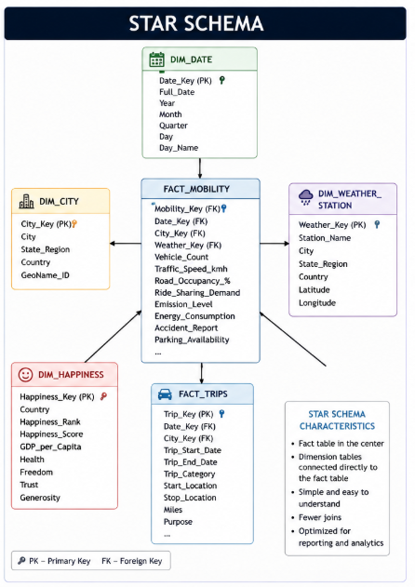
Star Schema

Slide 9
Data Model Relationships
Date Links
Filter Behavior
Model Rules
Dim_Date[Date] → Fact_Mobility[Mobility_Date] (1:N)
Dim_Date[Date] → Fact_Trips[Trip_Start_Date] (1:N)
Cardinality: Many (1*)
Cross-filter direction: Single
Dim_Date set as official Date table. Relationships built only where valid keys existed.

Slide 10
DAX Implementation
Key Measures
Calculated Column
Total Vehicles =
SUM(Fact_Mobility[Vehicle_Count])
Average Traffic Speed =
AVERAGE(Fact_Mobility[Traffic_Speed_kmh])
Total Trips =
COUNTROWS(Fact_Trips)
Traffic Speed Category =
SWITCH(TRUE(),
[Speed_kmh]<20, "Low",
[Speed_kmh]<40, "Moderate",
"High")
Measures react to filter context; calculated columns tag each row for categorization.

Slide 11
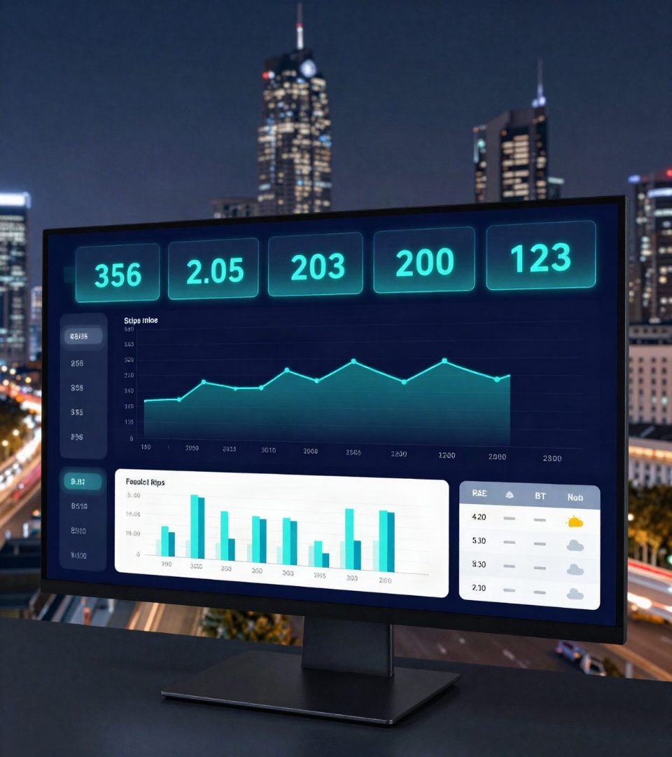
Mobility Dashboard
KPI Cards: Total Vehicles, Avg Speed, Road Occupancy, Ride-Sharing Demand
Charts: Volume Over Time, Volume by Speed, Trips by Purpose
Filters: Year, Weather, Traffic Condition
Transforms the data model into an interactive interface

Slide 12
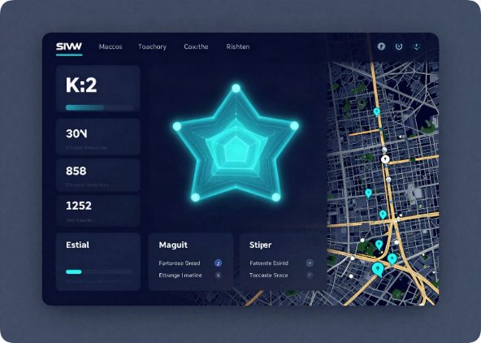
Conclusion & Future Scope
Milestone 2: Built structured Power BI model with Fact/Dimension architecture
Added Date dimension and DAX-driven KPIs for analysis
Next: Time-intelligence and map-based traffic visualization
Next: Traffic-flow prediction and accident-risk analysis

